Slide 1
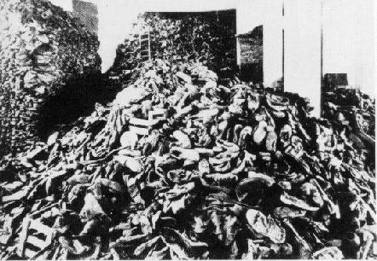
THE HOLOCAUST

Slide 2
OBJECTIVES:
DEFINE THE TERMS HOLOCAUST AND GENOCIDE.
DESCRIBE ANTI- JEWISH POLICIES PASSED BY THE NAZIS IN THE 1930’S.
IDENTIFY AND DESCRIBE HITLER’S “FINAL SOLUTION” PROGRAM.
DESCRIBE THE CONCENTRATION AND DEATH CAMPS USED IN WW II.

Slide 3
DEFINTIONS:
HOLOCAUST
A PROGRAM OF MASS MURDER
GENOCIDE
THE ANNIHILATON OF ENTIRE RACE OF PEOPLE

Slide 4
HOLOCAUST STATISTICS

Slide 5
PROGRESSION OF DISCRIMINATION TOWARDS JEWS
The NAZI party and Adolf Hitler seized power in 1933 and slowly began their program against the Jews of Germany
In 1933 there were 566,000 Jews living in Germany.
Each new year in Germany led to harsher policies directed towards the Jews.

Slide 6
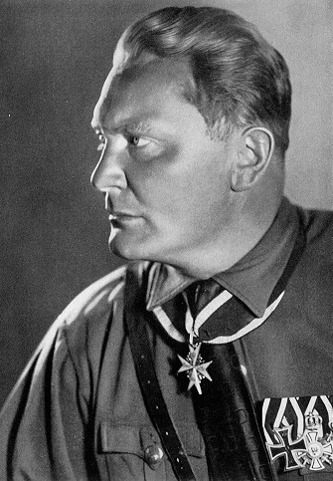
1933
NAZIS boycott Jewish businesses
issue decree that defines non-Aryans
Hermann Goering creates the GESTAPO
first concentration camps are built
Dachau - 3/22/33

Slide 7
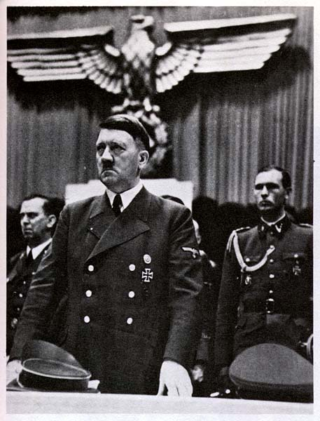
1934
Jews are not allowed to have national health insurance
the SS (Schutzstaffel) is formed
Hitler becomes Der Fuherer and receives a 90% approval rating from the people

Slide 8
1935- Nuremberg Race Laws

Slide 9
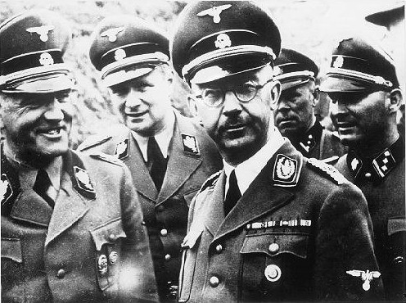
1936
SS Deathshead division is created to guard camps
Heinreich Himmler is appointed Chief of the German Police
Olympic games in Berlin, Jews treated better - briefly.

Slide 10
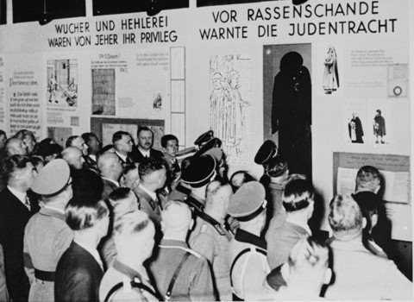
1937
Jews are not allowed to teach Germans
not allowed to be accountants or dentists
“Eternal Jew” exhibit opened in Germany
this promoted stereo-types of Jews and warned Germans

Slide 11
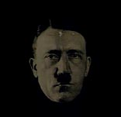
1938
Nazi troops enter Austria
League of Nations considers helping Jews fleeing Hitler, but no country will take them
Jews are not allowed to practice medicine

Slide 12
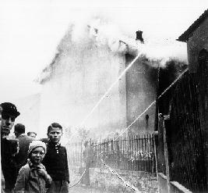
1939-KRISTALLNACHT
Night of Broken Glass
Jewish stores, shops and synagogues burned down
Took place because a German official was killed in Paris by a Jew
November 9, 1939

Slide 13
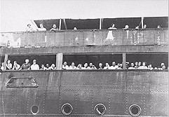
1939
Reinhard Heydrich is ordered to speed up emigration of Jews
The St. Louis is turned away from the US.
Jews must hand over all gold and silver.
Nazi troops seize Czechoslovakia
350,000 Jews

Slide 14
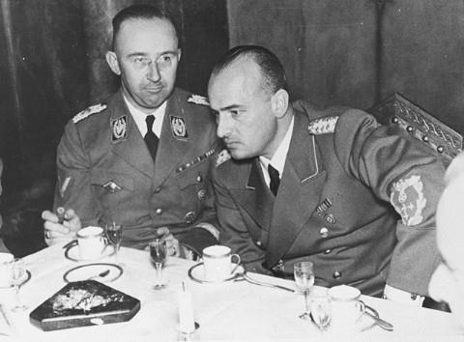
POLAND 1939
Sept. 1, 1939 Nazis invade Poland
3.35 million Jews
Hans Frank becomes governor of Poland
Forced labor decree issued and all Jews must wear yellow stars
“I ask nothing of Jews except that they should disappear”

Slide 15

1940
German Jews are deported to Poland
Ghettos of Lodz, Krakow and Warsaw are sealed off.
Total of 600,000 Jews
These ghettos will be liquidated starting in 1942
German soldiers rounding up Jews to be placed in ghettos

Slide 16
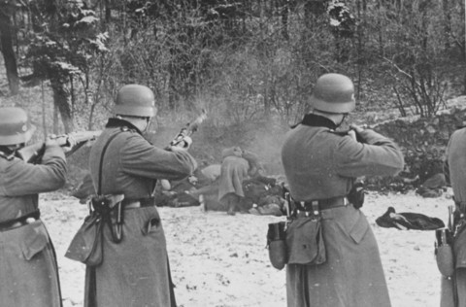
1941
Nazis invade the Soviet Union
Jewish population of 3 million
Hitler issues infamous “Commissar Order”
SS Einsatzgruppen follow advance of German Army
“Liquidate all Communist officials you encounter!

Slide 17
Einsatzgruppen
SS “Special Action Groups” organized in early years of war by Reinhard Heydrich
Heydrich organized 4 large groups (A,B,C,D) in Soviet Union
Competition between group leaders to see who could kill the most Jews
1,300,000 Russian Jews killed by end of war by these “mobile killing units”

Slide 18
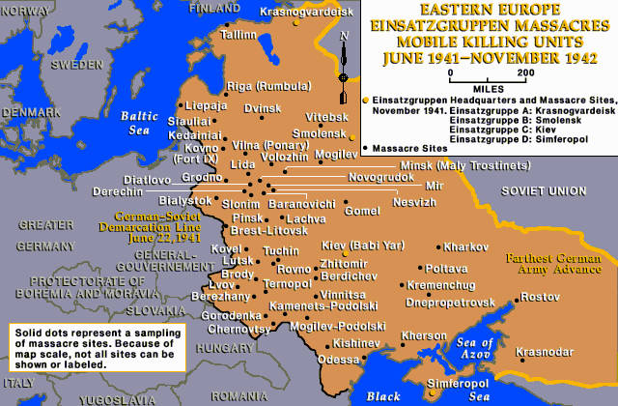
EINSATZ AREA OF OPERATIONS

Slide 19
Wannsee Conference
Heydrich was ordered by Hermann Goering to prepare a “final solution” to the Jewish question
Heydrich organized a meeting with 15 top Nazi officials in Berlin = Jan. 20, 1942
Nazis would attempt to exterminate the entire Jewish population of Europe, an estimated 11 million persons

Slide 20
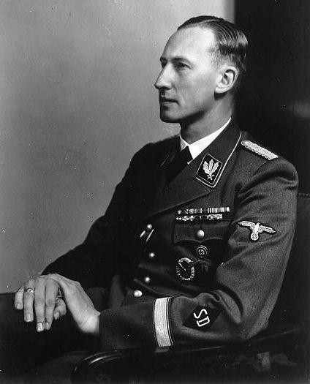
Reinhard Heydrich
Nicknamed “The Blond Beast” and “Hangman Heydrich”
second in command of Gestapo and SS
principle planner of the Final Solution
Brigadier General in SS at the age of 30

Slide 21
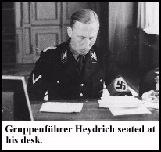
Heydrich and Final Solution
“Europe would be combed of Jews from East to West”
“Madagascar Plan”
ordered Einsatzs to round up and kill Jews in occupied countries
leader of RSHA

Slide 22
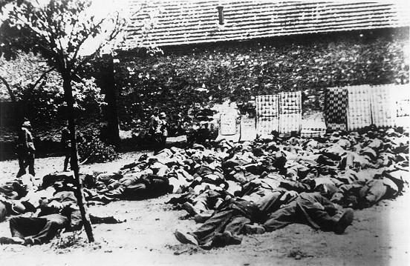
Heydrich assassinated 1942
Czech underground agents bombed his car
SS hunted down and killed 1000 suspects
Czech town of Lidice was liquidated
Hilter called him “The man with the iron heart.”
172 men shot in village of Lidice in retaliation.

Slide 23
FINAL SOLUTION
“Now judgement has begun and it will reach its conclusion only when the knowledge of the Jews has been erased from the earth!” Nazi Newspaper
there were 3 phases of the Nazi plan to wipe out the Jewish population of Europe

Slide 24
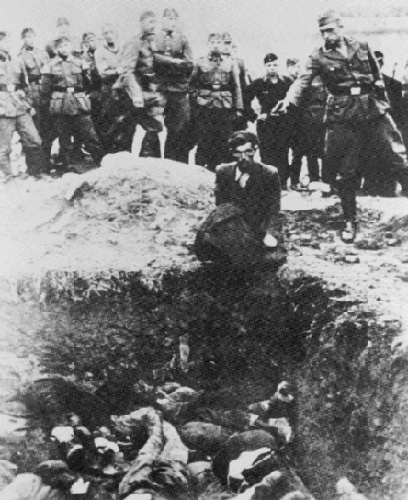
Phase 1 = Shooting
Jews were rounded up and told they were to be relocated
They were taken to the woods and were shot one by one
their bodies were buried in mass graves

Slide 25
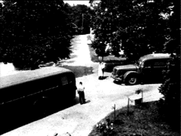
Phase 2 = Gas Vans
Again, Jews were rounded up and told they were to be relocated in vans
The vans were equipped so that the van’s exhaust was piped back into the van
700,000 Jews killed in Vans

Slide 26
Problems with Phases 1,2
The Nazis encountered several problems with the executions and gas vans
First, they were both taking to much time
Second, resources such as gas and munitions were becoming scarce
Third, soldiers involved were beginning to have psychological problems with what they were doing.

Slide 27
Phase 3 = The Camps
Nazi leaders decided to drastically speed up the Final Solution
there were two different types of camps:
CONCENTRATION CAMPS
EXTERMINATION CAMPS
Jews from all over occupied Europe were to be brought here.

Slide 28
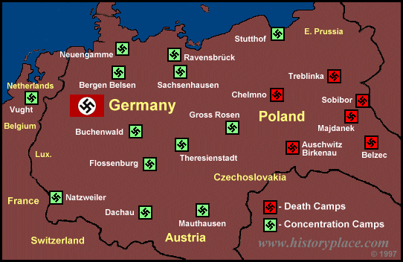

Slide 29
CONCENTRATION
100 of these in Nazi-occupied Europe
prisoners used for forced labor
prisoners usually lasted less than 1/2 year
communists, homosexuals, criminals, social-democrats, artists.
First camp was opened in 1933, right after Nazis came to power

Slide 30

RAVENSBRUCK
Camp for women only
run by German women who were criminals
prisoners worked on remodeling furs
50,000 killed
14,000 rescued by Swedish diplomat
Count Folke Bernadette negotiating for prisoners

Slide 31

THERESIENSTADT
Most humane camp
well connected Jews and war veterans
Jews married to Aryans could pay to go to this camp
Red Cross inspected this camp, good rating
stop over on the way to Auschwitz
Jewish band playing for Red Cross inspection team

Slide 32
EXTERMINATION
Started out as ordinary concentration camps
later modified with gassing installations for use on humans, now “DEATH CAMPS”
two sub-groups:
1) Majdanek and Auschwitz, Birkenau
2) Operation Reinhard camps and Chelmno
“NAZIS GET CLOSE TO CREATING HELL ON EARTH!!!”

Slide 33
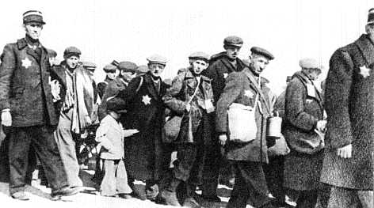
CHELMNO
Jews from the Lodz ghetto in Poland sent here
First death camp built = 1941
First to use Gas Vans on Jews

Slide 34
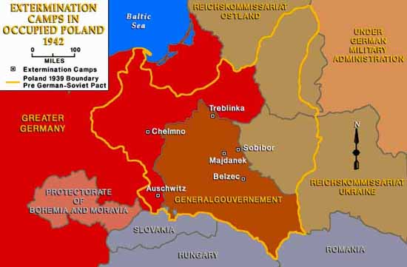
CAMPS IN POLAND

Slide 35
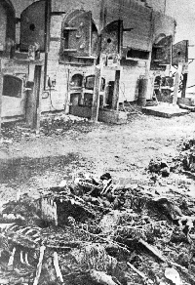
MAJDANEK
Established in 1941 as a POW camp
started its part in the Final Solution in 1942
Jews, Poles and Soviet POW’s sent here
had two gas chambers to exterminate

Slide 36
AUSCHWITZ
Started operations in January 1940 (Poland)
Himmler chose Auschwitz as the place for the Final Solution
had 4 gas chambers/crematories by 1943
mass killings with Zyklon B gas
commanded by Rudolph Hoess
recorded 12,000 kills in one day

Slide 37
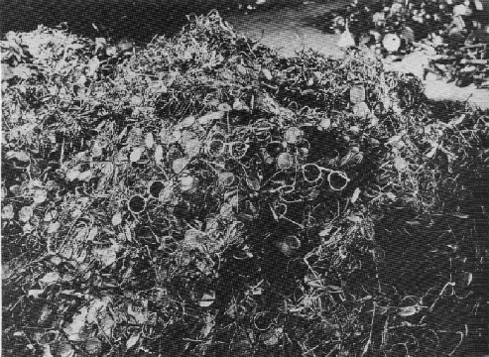
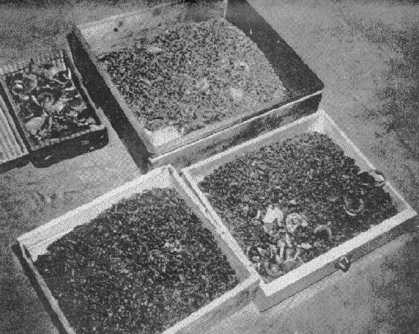
THE SS AT AUSCHWITZ
ORDERED TO TAKE ALL POSSESSIONS FROM JEWS
TEETH WITH GOLD
PILES OF GLASSES

Slide 38
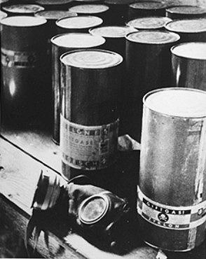


ZYKLON-B
GAS USED TO KILL VERMIN. IT WAS INEXPENSIVE COMPARED TO GAS. DROPPED FROM CEILINGS

Slide 39
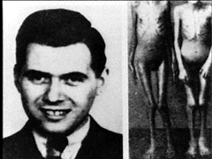
Dr. Josef Mengele
Arrived in Auschwitz in May of 1943
SS Doctor who had power of life/death
performed medical experiments on Jewish children
“ANGEL OF DEATH”

Slide 40
MEDICAL EXPERIMENTS
Sterilization of men and women
endurance of pain to high and low temperatures and pressure
experiments on twins to increase number of multiple births to Aryan women
injections of phenol to kill patients
Dr. Mengele attempted to sew children together to make Siamese twins

Slide 41
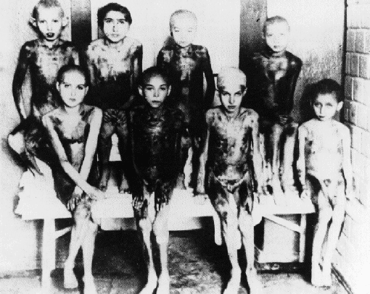

MEDICAL EXPERIMENTS
EXTRACTED HUMAN ORGANS
EXPERIMENTS ON CHILDREN IN AUSCHWITZ

Slide 42
OPERATION REINHARD
Largest single massacre of Holocaust
March 1942-November 1943
named after Reinhard Heydrich
carried out at three camps, run by the SS
every Jew that arrived at one of the camps would be dead in 2 hours.
Total of 1,700,000 Jews killed

Slide 43

BELZEC
MARCH 1942
JEWS FROM LUBIN GHETTO- POLAND
OPERATIONS STOP DECEMBER 1942
CAMP WAS DISMANTLED AND PLOWED OVER AND PLANTED ON

Slide 44

SOBIBOR
MAY 1942
3 GAS CHAMBERS
ESCAPE OF 300 JEWS AND SOVIET POW’S
ONLY 50 LIVE
GAS CHAMBERS SHUT DOWN AFTER ESCAPE

Slide 45

TREBLINKA
JEWS FROM WARSAW GHETTO
10 GAS CHAMBERS
LOCATED EAST OF WARSAW
BODIES WERE BURNED IN OPEN PITS
AUGUST 1943

Slide 46
Camp Totals

Slide 47
STATISTICS BY COUNTRY
Jewish population before, Jewish population after Holocaust

Slide 48
THE END

